Slide 1

NBA Player Analysis
A Data Science Capstone Project,
by Christos Magganas

Slide 2

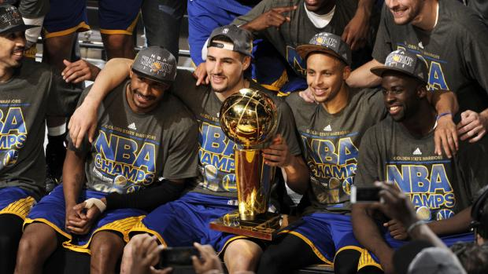
Objective
The goal of this project is to create an accurate predictor for the metric RPM. Real-Plus-Minus is an unbiased comparative metric to evaluate player value.
Specifically, a player's estimated on-court impact on team performance, measured in net point differential per 100 offensive and defensive possessions.
In 2015, Stephen Curry had a real-plus-minus of 9.34
(on average his team would score 9.34 more points when he was playing compared to when he was out)

Slide 3
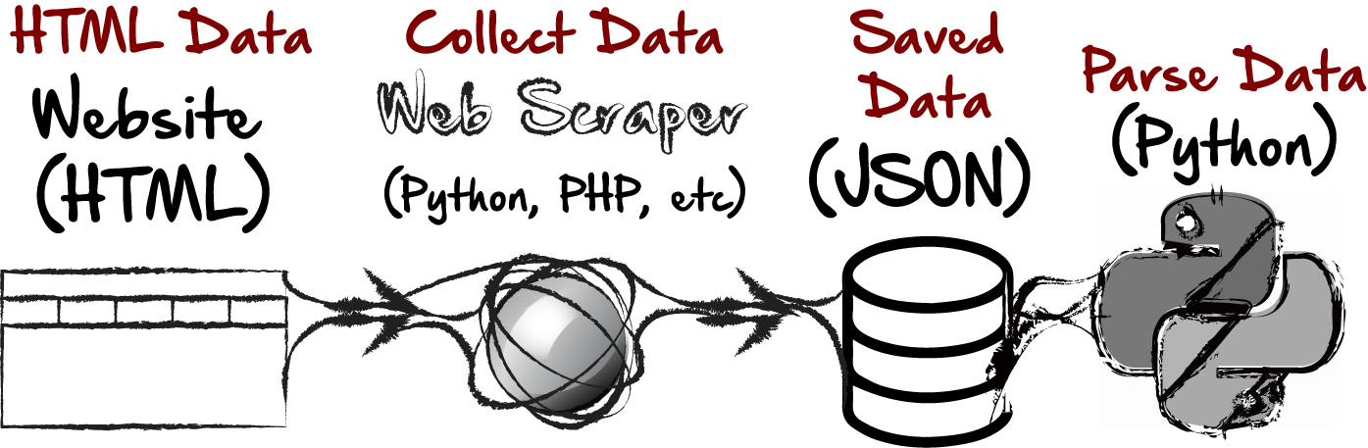
Data Collected to be analyzed
Data from ESPN and Basketball-Reference from the years 2014 - 2018 was collected in the manor as seen below

Slide 4
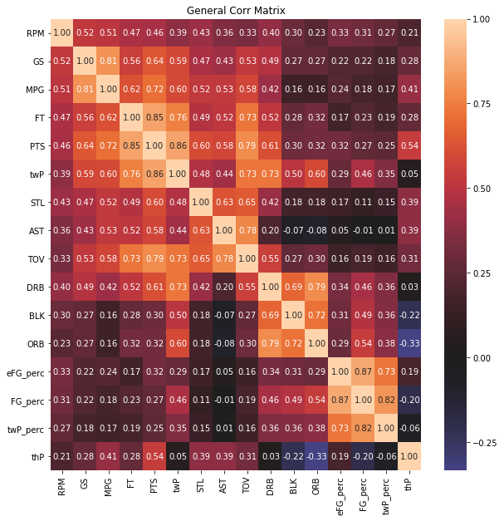
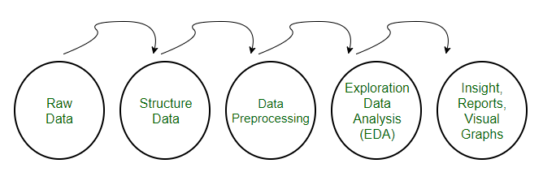
Feature Selection
Determining which features have the strongest relationships to the target variable and each other is critical when building a model. Separating the correlated features from each other is important to understand how each component will determine prediction.

Slide 5
Applying Machine Learning Techniques
Building a model with regression:
Linear, Ridge, Lasso, Decision Tree
Cross Validating and Testing:
Ensuring model is best for unseen data
Partial Component Analysis & Reduction:
Tuning parameters
Reducing Model by using only essential components

Slide 6

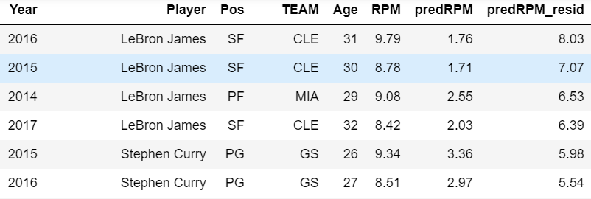
Secret to Success
Although, to the best of our ability, we created a model that can predict the RPM of an individual player fairly accurately with only their individual stats (points, assists, etc.)
The best players have intangible qualities that are undervalued by the individual stats used to predict RPM.
We see the best players have been underrated because they contribute more to team than their individual stats would suggest.

